Slide 1

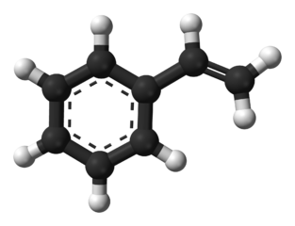

Slide 2
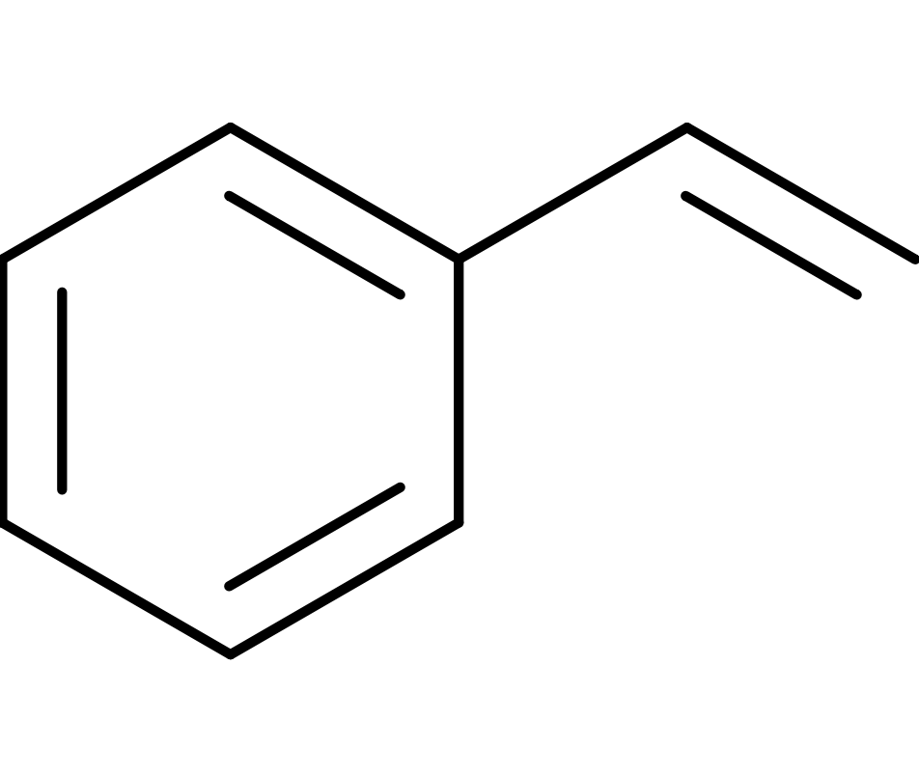
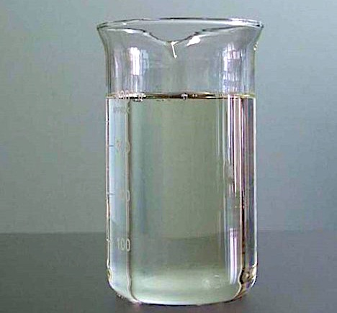
Group member :- 1)Ramakant 2)Hemnath 3)Kalyani 4)Dhanaram 5)Karan
Styrene
Introduction
What is Styrene?
Manufacturing of Styrene
Styrene Effects on the Health
Environmental Concerns
Styrene gas Leakage

Slide 3

Conclusion

